Slide 1

Mix & Master
By the 7 deadly cins

Slide 2
Introduction
Team Members: Abdulaziz Alamro, Abdullah Banawas, Bandar Banawas, Antowyn Cauley, Nathan Leyden, Ryann Palacio, Chawon White
Project Name: Mix & Master
Description: A Cocktail Recipe app where users can search cocktails, favorite cocktails, and add cocktails to a virtual cabinet.

Slide 3
Project Management
Process – The process that we selected was Agile Programming. One of the main reasons is because it allowed us to change things accordingly during our sprints. It also allowed us to constantly supply feedback throughout our development cycle on any code or concepts we worked on.
Project Manager: Chawon White
Shared Code through GitHub
Group communication consisted of in-class and out-of-class meetings along with a group text message.
3 Sprints were used during the development of our program

Slide 4
Sprint 1: Use Cases and UML Design
In the first spring, the group worked together on the UML design and the Use cases for our program
We chose the sequence Diagram
The group produced 15 different use cases for the program

Slide 5
Sprint 2: Different Classes
The second sprint is where we started designing the code for the multiple classes for our program
The classes that were worked on were:
Drink Class, Ingredient Class, Cabinet Class, User Class, and Favorites Class

Slide 6
Sprint 3: GUI
During our last sprint, our group worked on the Graphical User Interface for our program
This includes windows popping up, switching between different windows, and what pops up when a button is selected.

Slide 7
Design
Sequence Diagram
Determine the order in which classes are accessed
Activity Diagram
Show all possible paths the user can take
Design Pattern
Iterator

Slide 8
Design Patterns
Iterator
Multiple Drink classes stored in maps
Normally input the key to access values
Can access key for each mapped drink
Allow for moving through maps without knowing key
Makes comparisons much easier

Slide 9
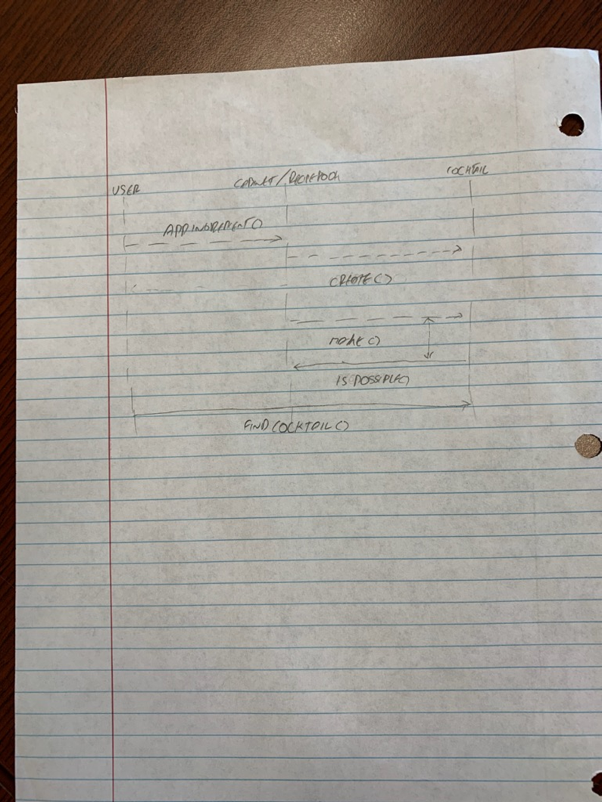
Sequence Diagram
The original diagram for our program
Later realized that this may not accurately reflect the current state of the program.

Slide 10
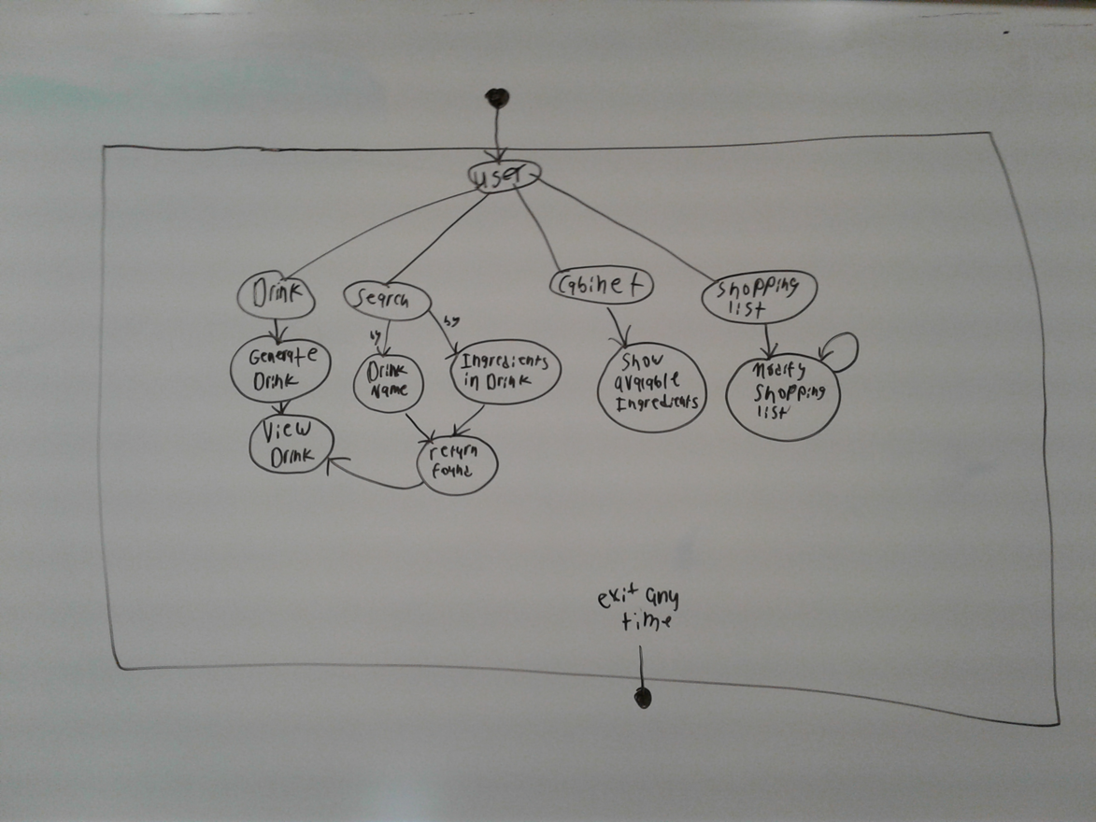
Activity Diagram
More accurately shows the current state of the program
Goes through the different paths in which you can use the program

Slide 11
Implementation – Search
Will take a string from the user
The class will search by drink name, drink ingredients or both
Separate functions for each
Uses iterators to go through the map without knowing the keys
Can match partial names (“Da” will match with Daiquiri or Dark & Stormy)
Saves any drink in a separate map to return multiple values
Friends with Recipe to allow for easy access to Ingredients

Slide 12
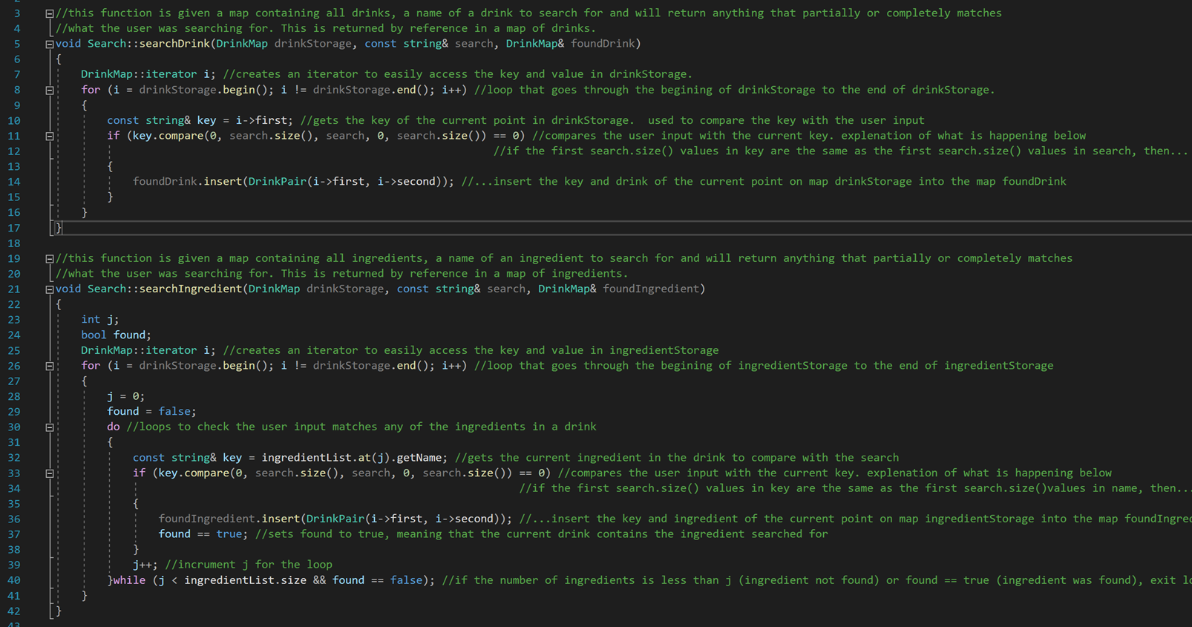
Implementation - Search

Slide 13
Test Plan
Test each button and confirm each output is correct
Pull up a random drink
Pull up favorites list
Check if shopping list works properly
Check ingredients in cabinet
Search for recipes based on drink name/ ingredients
Display a found drink

